Slide 1
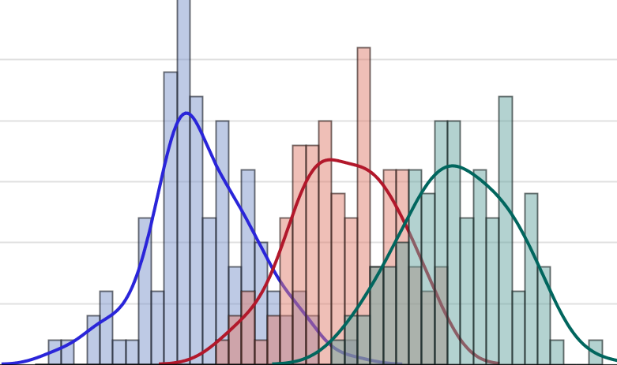

Restructuring SAS Data Sets
Introduction to Data Management and Statistical Computing
Notes:
Play intro music for 5 sec.

Slide 2
Data Structures
Person-level (Wide) data: Each person (observational unit) has one observations and multiple variables contain data for each measurement.
Notes:
Usually we think of this in terms of longitudinal data, where each person has multiple follow-up occasions over time.
However, this can also apply to cross-sectional multilevel data where your data are nested or clustered.

Slide 3
Baby Birth Weights at 3, 6, 9 , and 12 Months
ID | Gender | Weight3 | Weight6 | Weight9 | Weight12
1001 | F | 9 | 13 | 16 | 17
1002 | F | 11 | 16 | 17 | 20
1003 | M | 17 | 20 | 23 | 24
1004 | F | 16 | 18 | 21 | 22
1005 | M | 11 | 15 | 16 | 18
1006 | M | 17 | 21 | 25 | 26
1007 | M | 16 | 17 | 19 | 21
1008 | F | 15 | 16 | 18 | 19

Slide 4
Data Structures
Person-level (Wide) data: Each person (observational unit) has one observation and multiple variables contain data for each measurement.
Person-period (Long) data: Each person has multiple observations - one for each measurement occasion.
Notes:
Usually we think of this in terms of longitudinal data, where each person has multiple follow-up occasions over time.
However, this can also apply to cross-sectional multilevel data where your data are nested or clustered.

Slide 5
Baby Birth Weights at 3, 6, 9 , and 12 Months
Person-level (Wide)
Person-period (Long)
ID | Gender | Weight3 | Weight6 | Weight9 | Weight12
1001 | F | 9 | 13 | 16 | 17
1002 | F | 11 | 16 | 17 | 20
ID | Gender | Months | Weight
1001 | F | 3 | 9
1001 | F | 6 | 13
1001 | F | 9 | 16
1001 | F | 12 | 17
1002 | F | 3 | 11
1002 | F | 6 | 16
1002 | F | 9 | 17
1002 | F | 12 | 20

Slide 6
Disadvantages of Person-level Data
Leads to noninformative summaries
Omits an explicit “time” variable
Inefficient when number and spacing of waves vary across individuals
Cannot easily handle the presence of time-varying predictors
-Singer and Willet, 2003

Slide 7
Demonstration
Restructuring (Reshaping) SAS Data Sets Using Iterative Processing

Slide 8
PDV
_N_ | _ERROR_ | ID | Gender | Weight3 | Weight6 | Weight9 | Weight12 | i | weight
1 | 0 | 1001 | F | 9 | 13 | 16 | 17 | 1
weights{1}
data baby_weight_long1;
set baby_weight;
array weights{4} weight3 - - weight12;
do i = 1 to 4;
weight = weights{i};
end;
run;

Slide 9
PDV
_N_ | _ERROR_ | ID | Gender | Weight3 | Weight6 | Weight9 | Weight12 | i | weight
1 | 0 | 1001 | F | 9 | 13 | 16 | 17 | 1 | 9
data baby_weight_long1;
set baby_weight;
array weights{4} weight3 - - weight12;
do i = 1 to 4;
weight = weights{i};
end;
run;

Slide 10
PDV
_N_ | _ERROR_ | ID | Gender | Weight3 | Weight6 | Weight9 | Weight12 | i | weight
1 | 0 | 1001 | F | 9 | 13 | 16 | 17 | 2 | 9
weights{2}
data baby_weight_long1;
set baby_weight;
array weights{4} weight3 - - weight12;
do i = 1 to 4;
weight = weights{i};
end;
run;

Slide 11
PDV
_N_ | _ERROR_ | ID | Gender | Weight3 | Weight6 | Weight9 | Weight12 | i | weight
1 | 0 | 1001 | F | 9 | 13 | 16 | 17 | 2 | 13
data baby_weight_long1;
set baby_weight;
array weights{4} weight3 - - weight12;
do i = 1 to 4;
weight = weights{i};
end;
run;

Slide 12
PDV
_N_ | _ERROR_ | ID | Gender | Weight3 | Weight6 | Weight9 | Weight12 | i | weight
1 | 0 | 1001 | F | 9 | 13 | 16 | 17 | 3 | 13
weights{3}
data baby_weight_long1;
set baby_weight;
array weights{4} weight3 - - weight12;
do i = 1 to 4;
weight = weights{i};
end;
run;

Slide 13
PDV
_N_ | _ERROR_ | ID | Gender | Weight3 | Weight6 | Weight9 | Weight12 | i | weight
1 | 0 | 1001 | F | 9 | 13 | 16 | 17 | 3 | 16
data baby_weight_long1;
set baby_weight;
array weights{4} weight3 - - weight12;
do i = 1 to 4;
weight = weights{i};
end;
run;

Slide 14
PDV
_N_ | _ERROR_ | ID | Gender | Weight3 | Weight6 | Weight9 | Weight12 | i | weight
1 | 0 | 1001 | F | 9 | 13 | 16 | 17 | 4 | 16
weights{4}
data baby_weight_long1;
set baby_weight;
array weights{4} weight3 - - weight12;
do i = 1 to 4;
weight = weights{i};
end;
run;

Slide 15
PDV
_N_ | _ERROR_ | ID | Gender | Weight3 | Weight6 | Weight9 | Weight12 | i | weight
1 | 0 | 1001 | F | 9 | 13 | 16 | 17 | 4 | 17
data baby_weight_long1;
set baby_weight;
array weights{4} weight3 - - weight12;
do i = 1 to 4;
weight = weights{i};
end;
run;

Slide 16
PDV
_N_ | _ERROR_ | ID | Gender | Weight3 | Weight6 | Weight9 | Weight12 | i | weight
1 | 0 | 1001 | F | 9 | 13 | 16 | 17 | 5 | 17
data baby_weight_long1;
set baby_weight;
array weights{4} weight3 - - weight12;
do i = 1 to 4;
weight = weights{i};
end;
run;

Slide 17
PDV
_N_ | _ERROR_ | ID | Gender | Weight3 | Weight6 | Weight9 | Weight12 | i | weight
1 | 0 | 1001 | F | 9 | 13 | 16 | 17 | 5 | 17
baby_weight_long1
ID | Gender | Weight3 | Weight6 | Weight9 | Weight12 | i | weight
1001 | F | 9 | 13 | 16 | 17 | 5 | 17

Slide 18
PDV
_N_ | _ERROR_ | ID | Gender | Weight3 | Weight6 | Weight9 | Weight12 | i | weight
2 | 0 | 1002 | F | 11 | 16 | 17 | 20 | 5 | 20
data baby_weight_long1;
set baby_weight;
array weights{4} weight3 - - weight12;
do i = 1 to 4;
weight = weights{i};
end;
run;

Slide 19
PDV
_N_ | _ERROR_ | ID | Gender | Weight3 | Weight6 | Weight9 | Weight12 | i | weight
2 | 0 | 1002 | F | 11 | 16 | 17 | 20 | 5 | 20
baby_weight_long1
ID | Gender | Weight3 | Weight6 | Weight9 | Weight12 | i | weight
1001 | F | 9 | 13 | 16 | 17 | 5 | 17
1002 | F | 11 | 16 | 17 | 20 | 5 | 20

Slide 20
baby_weight_long1
ID | Gender | Weight3 | Weight6 | Weight9 | Weight12 | i | weight
1001 | F | 9 | 13 | 16 | 17 | 5 | 17
1002 | F | 11 | 16 | 17 | 20 | 5 | 20
1003 | M | 17 | 20 | 23 | 24 | 5 | 24
1004 | F | 16 | 18 | 21 | 22 | 5 | 22
1005 | M | 11 | 15 | 16 | 18 | 5 | 18
1006 | M | 17 | 21 | 25 | 26 | 5 | 26
1007 | M | 16 | 17 | 19 | 21 | 5 | 21
1008 | F | 15 | 16 | 18 | 19 | 5 | 19

Slide 21
PROC TRANSPOSE data = input-data-set
<out = output-data-set>
<name = variable-name>;
BY variable(s) <NOTSORTED>;
VAR variable(s);
ID variable(s);
RUN;

Slide 22
Demonstration
Restructuring (Reshaping) SAS Data Sets Using PROC TRANSPOSE

Slide 23
Practice: Restructuring SAS Data Sets
The data set work.bmi contains data about participant’s BMI over a four year period after a diet and exercise intervention. In this practice, you want to restructure the data set from person-level (wide) to person-period (long) data in preparation for analysis.
Steps:
Open the SAS program named m7.5_lecture_practice_Restructuring
Run the existing DATA step to create the work.bmi data set, and view it.
Write a DATA step to restructure work.bmi to person-period data, and create a new data set named work.bmi_long.
work.bmi_long should only contain the variables: ID, Gender, Year, and BMI.
Write and submit a PROC PRINT step to create a list report that shows all the observations in work.bmi_long.

Slide 24
References
Cody R. Learning SAS by Example: A Programmer’s Guide. Cary, NC: SAS Institute Inc.; 2007.
Singer, J. & Willet J. Applied Longitudinal Data Analysis. New York, NY: Oxford University Press; 2003.
Cody R. & Smith K. Applied Statistics and the SAS Programming Language (5th ed.). Upper Saddle River, NJ: Person Prentice Hall; 2006.
SAS Institute. SAS Programming 1: Essentials [e-learning course]. Cary, NC: SAS Institute Inc.; 2012. Accessed: December, 2013

